Slide 1
Towards Accurate Marker-less Human Shape and Pose Estimation over Time
Yinghao Huang1, Federica Bogo2, Christoph Lassner3,∗, Angjoo Kanazawa4 Peter V. Gehler5,∗, Javier Romero3, Ijaz Akhter6, Michael J. Black1
1Max Planck Institute for Intelligent Systems, T¨ubingen, Germany 2Microsoft, 3Body Labs Inc., 4UC Berkeley 5University of W¨urzburg, 6Australian National University
arXiv:1707.07548v4 [cs.CV] 20 Dec 2017

Slide 2
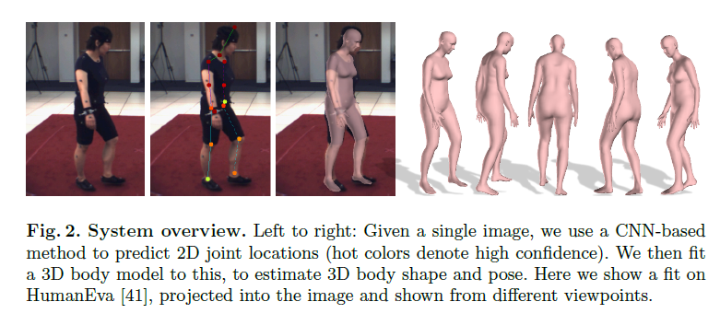
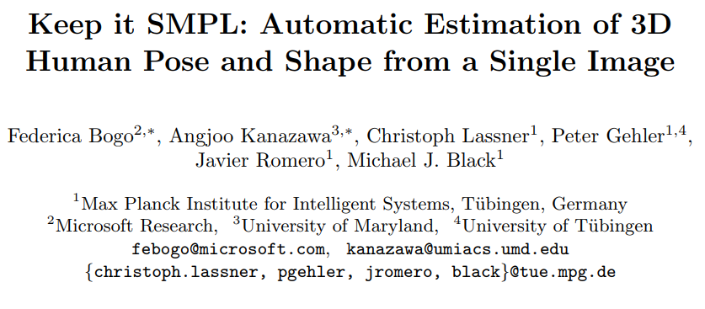
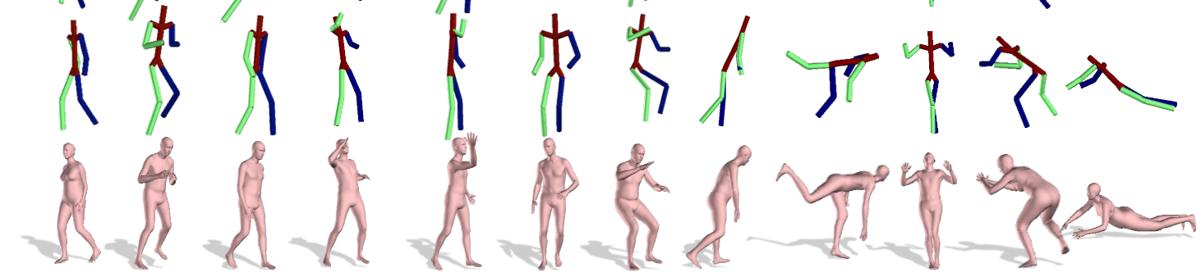
This paper is an extended version of “Keep it SMPL: Automatic Estimation of 3D Human Pose and Shape from a Single Image”.
DeepCut predict 2D body joints – provide confidence value
Fit 3D body model minimize weighted error term using SMPL

Slide 3
This paper =
Keep it SMPL(only use joints)
+ silhouette + processing several consecutive frames
Anyway, This paper consists of a combination of the techniques mentioned below.
Deepcut : Joint subset partition and labeling for multi person pose estimation.
Unite the people : Closing the loop between 3D and 2D human representations.
SMPL : A skinned multi-person linear model
Powell’s dogleg method : Numerical optimization: Springer science & business media.
DCT : Bilinear spatiotemporal basis models.

Slide 4
I will explain step by step according to the order of the algorithm.
Step1
Step2
Step3
Step4

Slide 5
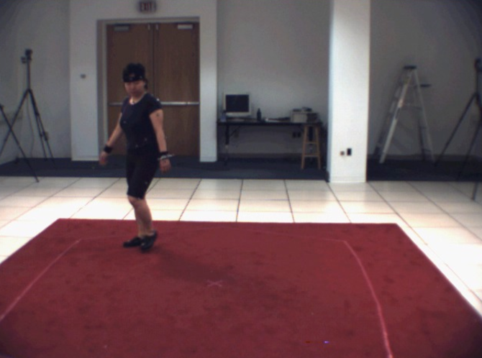
Step1
input
500x500 images
(HumenEva dataset[42])
4 views

Slide 6
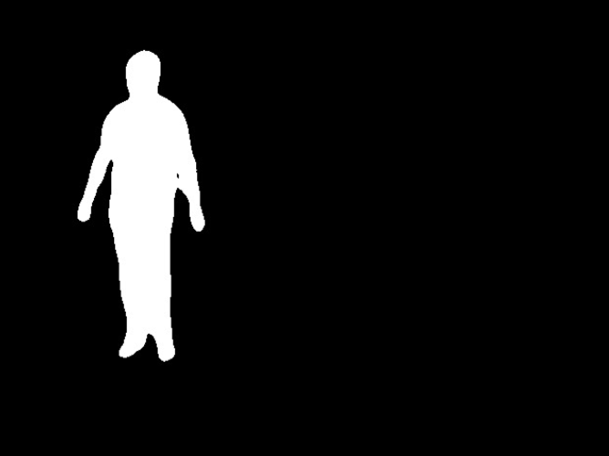
Step2
Use DeepCut[35] and Unite the people[26]
z
Estimate 2D joints
Segmente silhouette

Slide 7
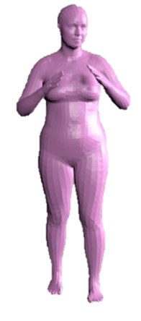
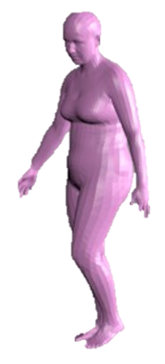
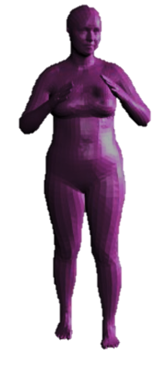


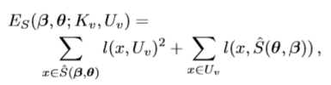


Step3
z
> Optimization problems are conducted using Powell’s dogleg method[32], OpenDR[29], Chumpy[1].
> 70 seconds for each frame
v=view

Slide 8
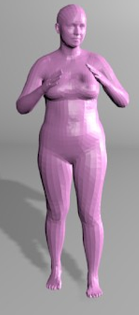
SMPL
SMPL
SMPL is deﬁned as M(β,θ;Φ),
β = a vector of shape parameters that are responsible for the 3D body shape due to identity.
θ = a vector of pose parameters representing body part rotations in a kinematic tree.
Φ = The ﬁxed parameters learned from a large number of 3D body meshes.

Slide 9
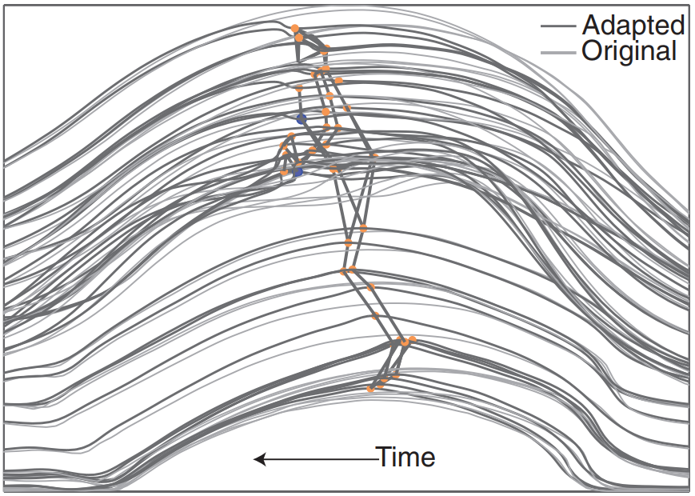
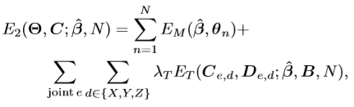
Step4
> Optimization problems are conducted using Powell’s dogleg method[32], OpenDR[29], Chumpy[1].
> Each temporal unit takes around 12 minutes.
Original and adapted trajectories
(Image from “Bilinear spatiotemporal basis models.[4]”. showing that this model inherently filters out high-frequency noise due to the use of DCT as a trajectory basis)

Slide 10
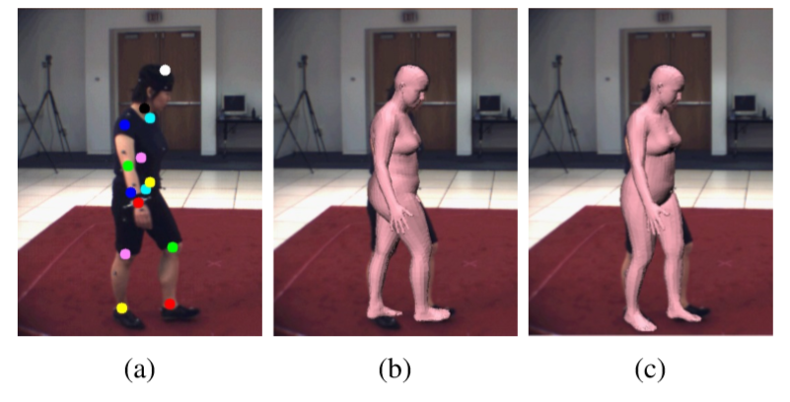
DCT
Figure 3: DCT[4] based temporal prior helps alleviate the leg swap problem.
a): Pose detection with leg swap;
b): MuVS without DCT prior;
c): MuVS with DCT prior.

Slide 11
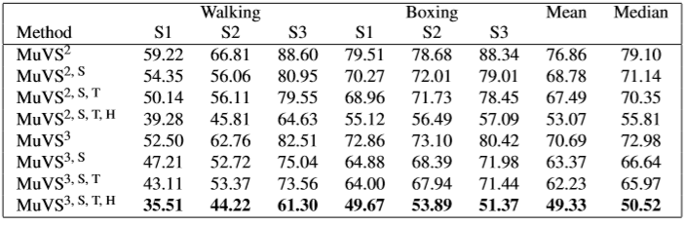
Experiment1
Ablation results on HumanEva.
3D joint errors in mm.
Here labels 2/3 mean using the ﬁrst 2/3 camera views;
S means silhouette ﬁtting term;
T means temporal ﬁtting term;
H means adding silhouette ﬁtting term at the second stage.

Slide 12
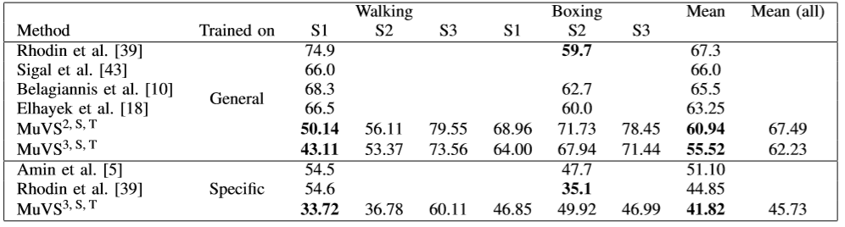
Experiment2
Ablation results on HumanEva.
3D joint errors in mm.
Here labels 2/3 mean using the ﬁrst 2/3 camera views;
S means silhouette ﬁtting term;
T means temporal ﬁtting term;
H means adding silhouette ﬁtting term at the second stage.

Slide 13
Conculution
Our method computes relatively accurate 3D pose and also returns a realistic and faithful human body mesh. Unlike previous work that assumes known silhouettes, needs user intervention, or limits the user motion, our algorithm works for general activities seen in daily life.
Future work will address more complex scenarios, like cluttered backgrounds, multiple people, and extreme poses. A key direction to make the method practical is to reduce the computational costs.

Slide 14
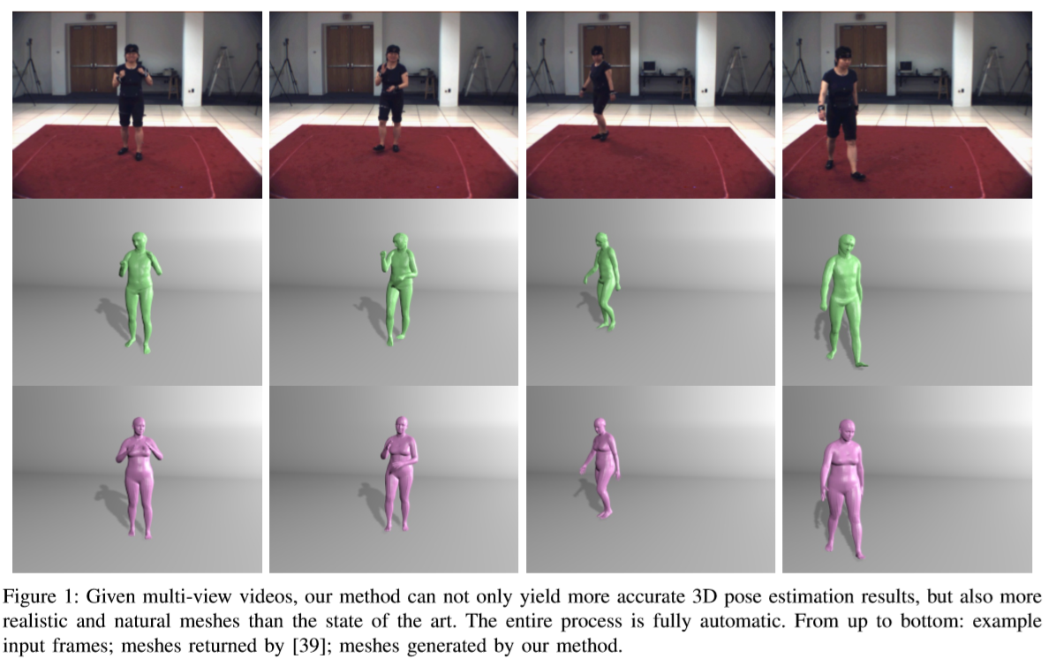
More results

Slide 15
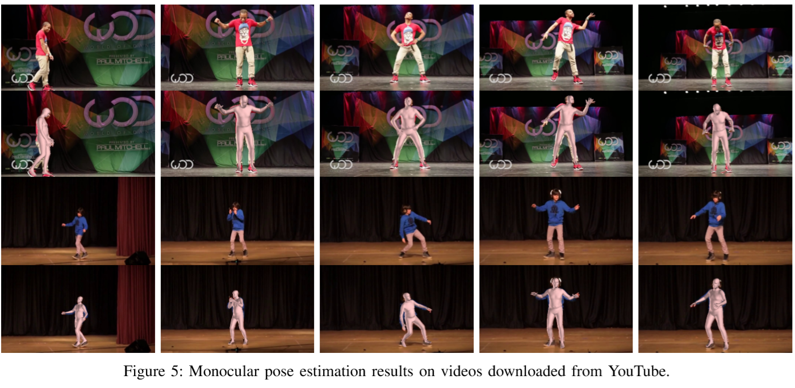
More results

